Slide 1


Green Pace
Security Policy Presentation
Developer: Jeremy Baldner
Notes:
Hello, my name is Jeremy Baldner, and I am here to present a security policy for Green Pace.

Slide 2

OVERVIEW: DEFENSE IN DEPTH
Notes:
Green Pace is an engineering company that specializes in custom software design and development for environmentally responsible entrepreneurs worldwide. To create custom software that is secure, a Defense in Depth approach is necessary. A standardized security policy will be used to provide guidance to the developers and security team. This slide provides an image showing a high-level overview of Defense in Depth and how the policies from this document relate to it.

Slide 3
THREATS MATRIX
Likely – This issue is most likely to happen.
Priority – Issues to focus on first. Higher P Value is higher priority.
Low priority – Issues to focus on lasts
Unlikely – This issue is unlikely to happen.
Likely STD-002-CPP: Data Value STD-003-CPP: String Correctness STD-004-CPP: SQL Injection STD-005-CPP: Memory Protection STD-009-CPP: Null Dereference STD-010-CPP: Divide by Zero | Priority STD-002-CPP: Data Value (P9) STD-003-CPP: String Correctness (P18) STD-004-CPP: SQL Injection (P18) STD-005-CPP: Memory Protection (P18) STD-008-CPP: Declarations (P6) STD-009-CPP: Null Dereference (P18) STD-010-CPP: Divide by Zero (P6)
Low priority STD-001-CPP: Data Type (P2) STD-006-CPP: Assertions (P4) STD-007-CPP: Exceptions (P4) | Unlikely SDT-001-CPP: Data Type STD-006-CPP: Assertions
Notes:
A threat matrix is used to evaluate the vulnerabilities found in the code. Comparing the vulnerability to the threat matrix can help determine how to prioritize the actions to fix the issue.
In the Top left corner, we have likely. This means the issue is more likely to happen. Priority shows the issues the need to be focused on first. A higher P value is a higher priority.
Low priority are the issues to focus on last. Unlikely means that these issues are less likely to happen in development.
Finding these vulnerabilities can be made simple by using an automation tool such as CPP Check, Astree, or CodeSonar.

Slide 4
10 PRINCIPLES
Validate Input Data: Data Type, Data Value, Exceptions, Divide by Zero.
Heed Compiler Warnings: Data Type, String Correctness, Divide by Zero.
Architect and Design for Security Policies: Memory Protection.
Keep It Simple: Assertions.
Default Deny: SQL Injection.
Adhere to the Principle of Least Privilege: SQL Injection.
Sanitize Data Sent to Other Systems: SQL Injection.
Practice Defense in Depth: SQL Injection.
Use Effective Quality Assurance Techniques: SQL Injection, Memory Protection, Assertions, Declaration, Null Dereference.
Adopt a Secure Coding Standard: String Correctness, SQL Injection, Memory Protection, Assertions, Exceptions, Declaration, Null Dereference.
Notes:
These are the 10 core security principles and the coding standards they relate to:
1. Validate Input Data: Verifies that input values from all sources match the intended data type. Input values that do not match the intended data type can cause undefined behavior in the program.
2. Heed Compiler Warnings: A program will still run with compiler warnings, but they need to be reviewed. They indicate unusual conditions that could lead to a problem in the code base (IBM, 2021).
3. Architect and Design for Security Policies: Reviews how the securities and safeguards are implemented in a system based on business requirements. This involves the organization’s IT network which includes the computer systems and the data.
4. Keep It Simple: Complex software results in technical debt. By only keeping the necessary security defined by the business requirements, the organization can prevent unnecessary costs with implementation, maintenance, and upgrades (Naor, 2020).
5. Default Deny: This model focuses on restricting access by default to all users. Activities can only be accessed by authorization and explicit permissions (Akyoo, 2023).
6. Adhere to the Principle of Least Privilege: Each user is only given minimal access to system resources and authorization they need to perform a function (NIST, 2023).
7. Sanitize Data Sent to Other Systems: All values from an outside source are considered tainted. All values should be checked to ensure they conform to the required constraints especially before sending to other systems (Seacord, 2013).
8. Practice Defense in Depth: A security strategy that utilizes variable barriers across multiple layers to prevent vulnerability from multiple exploits. The intent is to ensure that attacks missed by one barrier will be caught by another (NIST, 2023).
9. Use Effective Quality Assurance Techniques: There are many different quality assurance techniques available. Utilize current best practice when determining which techniques to include on a project. Testing must be thorough and complete to prevent vulnerabilities.
10. Adopt a Secure Coding Standard: Secure coding standards are rules used to follow to properly develop a program based on the organization’s policy and principles (SNHU, 2023).

Slide 5
CODING STANDARDS
Coding Standard | Severity | Likelihood | Remediation Cost
STD-002-CPP: Data Value | High | Likely | High
STD-008-CPP: Declaration | High | Probable | High
STD-003-CPP: String Correctness | High | Likely | Medium
STD-004-CPP: SQL Injection | High | Likely | Medium
STD-005-CPP: Memory Protection | High | Likely | Medium
STD-009-CPP: Null Dereference | High | Likely | Medium
STD-007-CPP: Exceptions | Medium | Probable | High
STD-006-CPP: Assertions | Medium | Unlikely | Medium
STD-0010-CPP: Divide by Zero | Low | Likely | Medium
STD-001-CPP: Data Type | Low | Unlikely | Medium
Notes:
The ten coding standards are listed in priority order. The system of prioritization is based on the severity, likelihood, and remediation cost. Standards with the highest severity and the time to fix take the highest priority to in awareness and prevention.
We can see that data value scored highest in all three categories, so it is priority number 1. Declaration is scored second since it is less likely. String correctness and SQL injection go hand in hand and I would consider SQL injection to be a subsection of string correctness. The list continues in this way with data type listed last due to scoring the lowest in all three sections.

Slide 6
ENCRYPTION POLICIES
Encryption in Rest: Data on a disk.
Encryption at Flight: Data being transmitted.
Encryption in Use: Data being accessed, processed, read, updated, or erased.
Notes:
Encryption in rest - Encryption at rest protects data that is stored on a disk. All data at rest should be encrypted using a standard best practice Advanced Encryption Standard (AES) algorithm. This will prevent access to the data. If the data is breached, it will be encrypted, and the attacker will be unable to read it.
Encryption at flight - Encryption in flight protects data that is being sent over a network. All data that is sent over the network will be encrypted with AES and have a key the receiver will use to decrypt the message. This prevents someone from intercepting the message and reading the sensitive information.
Encryption in use - Encryption in use protects data that is being accessed, processed, read, updated, or erased. Data in use will be encrypted with AES and prevent unauthorized access in real time. Adding encryption in use will protect the data throughout the entire lifecycle and prevent traditional vulnerabilities such as cloud infrastructure and unsecure endpoints.

Slide 7
TRIPLE-A POLICIES
Authentication: Verifying the user.
Authorization: Level of access that the user has.
Accounting: Audit trail to follow a user's actions through the system.
Notes:
Authentication - Authentication stands for how users are identified. This usually involves unique information such as usernames, passwords, certificates, and keys. Secure authentication will prevent malicious users from gaining access to the system.
Authorization - Authorization defines the level of privilege that a user has. A customer should have less authorization than an administrator but both profiles should adhere to the Principle of Least Privileged. A user with lower authorization would be able to send requests to the database. A user with higher authorization would be able to make changes to the database and add new users.
Accounting - Accounting tracks the user’s actions in the system. This provides an audit trail for review as needed. If an incident were to occur, Green Pace would be able to track which files were accessed and what parts of the application were used at what time. This is useful for a retrospective view to determine vulnerabilities.

Slide 8
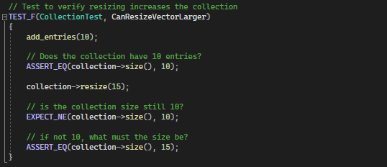
Unit Testing – Vector Memory
Notes:
For unit testing, we used Google Test for C++ in Visual Studio. This shows a positive unit test for resizing a vector larger. It will return correct if it asserts that they vector size increased after performing an operation.

Slide 9
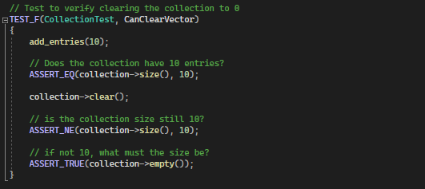
Unit Testing – Vector Memory
Notes:
The next test shows another positive unit test for clearing a vector. It will return correct if the unit test asserts the vector is empty after the clear operation.

Slide 10
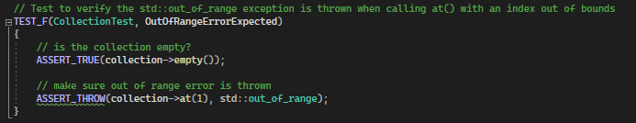
Unit Testing – Vector Memory
Notes:
This test shows a negative unit test to verify an error will occur. The unit test will return correct if it asserts that the program throws an out-of-range error after attempting to access invalid memory. To improve the code, a catch statement may be implemented to prevent any runtime errors.

Slide 11
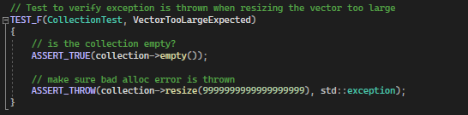
Unit Testing – Vector Memory
Notes:
The last test is another negative unit test to verify that resizing a vector too large will result in an exception being thrown. To improve this test, a custom throw statement may be beneficial to verify which exception is being thrown from the vector.

Slide 12

AUTOMATION SUMMARY
Notes:
Automation will be used for the enforcement of and compliance with the standards defined in this policy. Green Pace already has a well-established DevOps process and infrastructure.
Automation is an excellent way to implement coding standards by utilizing static analysis. Resources such as Astree, Cppcheck, and SonarSource provide lightweight technology that helps developers deliver clean and secure code with the analysis review. The automation will be included in the design and verify and test phases of Green Pace’s DevSecOp pipeline. This will allow developers to catch areas for improvement before reaching the production cycle. This will limit the amount of refactoring required and reduce the overall technical debt.

Slide 13
RISKS AND BENEFITS
Don’t leave security to the end.
Protect your company’s reputation.
Make Defense in Depth work for you.
“It takes 20 years to build a reputation and few minutes of cyber-incident to ruin it.”
― Stephane Nappo
Notes:
Starting with security is a proactive approach that has been proven to better protect applications and their data. The Federal Trade Commission recommends implementing security fundamentals in the initial design can reduce technical debt, prevent breaches, and better control data (Federal Trade Commission, 2015).
There are many hackers with different motivations that may pose a threat to this company. Understanding there may be a malicious attempts should promote you to be proactive and protect your company's reputation from a data breach. An example is a recent attack on MGM casinos last year. The casino ended up being such down for 10 days, costing them millions of dollars, ruining their reputation after their system was hacked.
Defense in depth is not a one size fits all. There are many layers that can be added or removed to fit the company’s current needs. Every layer of defense that is added requires implementation and maintenance. This will take time away from the security team or may require additional hires. This will increase the cost of wages and add additional costs related to licensing.

Slide 14

RECOMMENDATIONS
Data Policy
Data Gathering
Data retention
Data Usage
Notes:
Adding a data retention policy would also benefit Green Pace. While it is important to protect the data gathered with Defense in Depth, you must also consider the data you are protecting. Data should only be gathered if it is essential to the company’s function. Unnecessary data can cost more to protect and store and can increase risks with data breaches.
Data that is not essential or out of data should be removed. This can reduce compliance fines, storage costs, and legal exposure from discoverable data.
Data usage should also be considered. The company should verify that the data is being used in a meaningful way. Extra exposure could result in a weak point in the company’s defense plan.

Slide 15

CONCLUSIONS
Defense in Depth has many layers.
Principles
10 principles
Encryption
Triple A
Coding standards
Tools
Testing
Make it work for you.
Notes:
Principles create the foundation to guide development. This includes the ten initial principles as well as the encryption at rest, in flight, and in use and the authentication, authorization, and auditing of users.
The ten coding standards offer examples of errors that may arise in code. Being aware of these errors and how to prevent them can reduce technical debt.
Tools such as Astree, CPP check, and CodeSonar are useful to statically analyze for code for errors.
Unit testing is useful to verify the program behaves in an expected manor. It is also a useful reminder to not leave testing to the end.
Ultimately, Defense in Depth is customizable to fit Green Pace’s current situation. Adding and removing layers will be essential when reviewing the technical and business requirements for the company. Staying up to date will help keep Green Pace and their clients protected.

Slide 16
REFERENCES
Akyoo, G. (2023). Fundamental Security Postures: Default Allow vs. Default Deny. Retrieved from Medium: https://medium.com/@gakyoo/fundamental-security-postures-default- allow-vs-default-deny- 539abfbbdba9#:~:text=The%20default%20deny%20model%20is,authoriz ed%20and%20explicitly%20permitted%20activities.
Carnegie Mellon. (2018). SEI CERT C Coding Standard. Retrieved from Confluence:https://wiki.sei.cmu.edu/confluence/display/c/SEI+CERT+C +Coding+Standard
IBM. (2021). Compiler Warnings. Retrieved from IBM: https://www.ibm.com/docs/en/ztpf/1.1.0.15?topic=warnings-compiler

